Slide 1

Promotional Marketing, Use of the term ‘Dr’, and ‘No. 1’ claims
Janet Taylor
Copy Advice Executive
Victoria Avery
Investigations Executive

Slide 2







What are the Learning Outcomes for today’s training?
The aim of today’s training is to equip you with greater knowledge and a wider understanding of the advertising rules on promotional marketing, “best” and “No.1” claims, and using the term “Dr” so your members can run effective and compliant campaigns.
By the end of today’s session you will feel confident in:
Explaining what is considered to be ‘Promotional Marketing’ and the types of promotions that are covered within the ASA and CAP’s remit.
Describing the key principles that need to be considered when preparing a promotion of any kind (e.g. Prize draws, competitions, instant wins, etc.)
Identifying what would be considered as ‘significant conditions’ and when / where these should be included.
Describing the issues that need to be considered when producing responsible promotions.
Identifying when the term ‘Dr’ is appropriate to use.
Understanding the requirements that need to be considered when making “best” or “no.1” claims.
Promotional Marketing, Use of the term ‘Dr’, and ‘No. 1’ claims
Notes:
RJ to cover

Slide 3


What will we be covering today?
Best/No.1 Claims
Price promotions
Use of the term ‘Dr’
Significant conditions
Promotional marketing
Prize promotions
Administration
Socially responsible promotions
Promotional Marketing, Use of the term ‘Dr’, and ‘No. 1’ claims
Notes:
RJ to cover

Slide 4
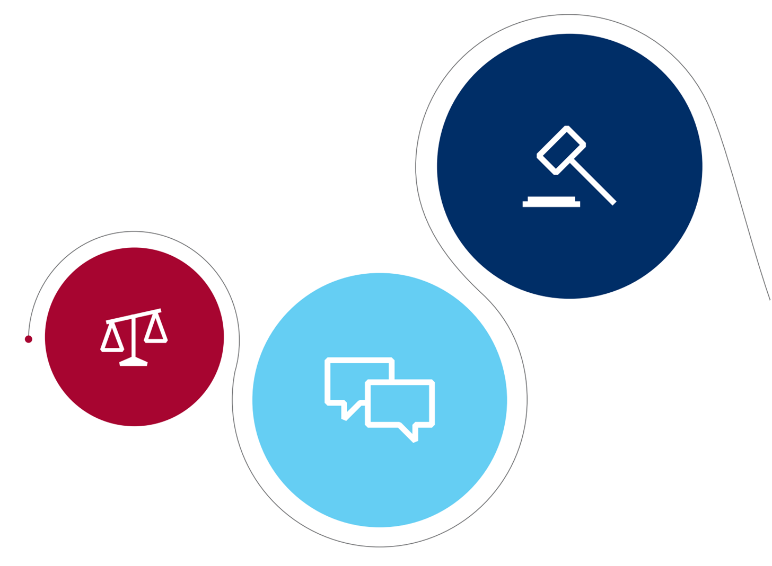


The Broadcast rules
“No. 1” and “Best” claims
Promotional Marketing, Use of the term ‘Dr’, and ‘No. 1’ claims
Notes:
CH

Slide 5



“No. 1” and “Best” claims
Usually regarded as objective comparisons
Need to be qualified – make the meaning of the claim clear
Objective claims must be supported by evidence
Comparative claims need to be verifiable
Promotional Marketing, Use of the term ‘Dr’, and ‘No. 1’ claims
Notes:
https://www.asa.org.uk/rulings/slip-enterprises-pty-ltd-a19-566554-slip-enterprises-pty-ltd.html - example of a puffery claim
https://www.asa.org.uk/advice-online/types-of-claims-best.html
https://www.asa.org.uk/advice-online/types-of-claims-no-1.html

Slide 6

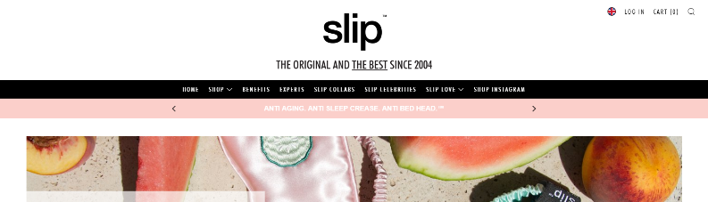
Slip Enterprises Pty Ltd
2020
Promotional Marketing, Use of the term ‘Dr’, and ‘No. 1’ claims
Notes:
https://www.asa.org.uk/rulings/slip-ent
1.Not upheld
The ASA understood that the complainant, who said their own pure silk pillowcase brand was established in 2005, did not believe that Slipsilk had been trading since 2004 and therefore challenged the claim “the original and the best since 2004” on that basis. We considered consumers would understand the references in the claim to “the original … since 2004” to be an objective claim that Slipsilk were the first company to produce and sell pure silk pillowcases targeted specifically at the beauty market, and that they began in 2004 and had been trading continuously since then. However, we considered that in the context of the overall claim the reference to “the best” would be understood as a subjective expression of Slipsilk’s opinion about their product and was therefore not capable of objective substantiation. Slipsilk had provided evidence of their company’s origin and position within the market, including product receipts and evidence of the registration of their company name and a domain name dated from 2004. We considered that this was sufficient evidence that the company had been in existence and was operating in 2004, prior to the complainant’s company. We therefore concluded that the claim had been substantiated and was not misleading.
erprises-pty-ltd-a19-566554-slip-enterprises-pty-ltd.html - PUFFERY

Slide 7

Procter & Gamble (Health & Beauty Care) Ltd
2018
Promotional Marketing, Use of the term ‘Dr’, and ‘No. 1’ claims
Notes:
Voiceover: “I asked my dentist which cleans better - an electric toothbrush or a manual one? She said definitely electric but don’t just get anyone, get one inspired by dentists … Oral B, the number one dentist recommended brand worldwide.”
https://www.asa.org.uk/rulings/procter---gamble--health---beauty-care--ltd-a17-400410.html
A TV ad for Oral B, that featured the claim “Oral B, the number one dentist recommended rand worldwide” did not breach the Code. They provided evidence from independent questionnaires. We acknowledged that the sample size of 5157 dentists from each region of the globe, with the dentists in those regions representing 72% of dentists worldwide, was sufficiently robust. The interviews were conducted blinded, and participants were asked various open ended questions about their toothbrush recommendations and ratings. The relevant question about electric toothbrush recommendations asked “What are all of the brands of electric rechargeable toothbrushes the dentists usually recommended to their patients”. Participants were given a list of different brands and asked to select all of the brand options that applied. The results showed that 22% of dentists selected Oral-B as one of their recommended brands which was 6.8 percentage points higher than the next most popular brand. We considered that the results demonstrated that Oral-B was the most selected option by dentists and therefore was the number one recommended brand worldwide.
Because the evidence supplied showed that Oral-B was the most recommended brand of electric toothbrush over any other brand worldwide, we concluded that the claim had been substantiated and was not misleading.

Slide 8

Centre For Medical Sciences & Research Ltd
2022
Promotional Marketing, Use of the term ‘Dr’, and ‘No. 1’ claims
Notes:
We considered that, in the absence of further qualification on the website and within the context of the educational environment, the use of the claim “London’s leading clinical skills and aesthetic medicine training provider” was ambiguous. We considered it would be understood by consumers to mean that they led every other London-based provider in terms of number of students or as measured objectively and independently in terms of the quality of the education provided. We therefore expected to see evidence to substantiate the claim on that basis, including evidence showing a comparison with all other relevant providers.
We considered that evidence showing two examples of students attending their training did not substantiate their claim that they were leading in terms of their students’ numbers when compared against other London training establishments providing the same courses. Similarly, we did not receive any evidence to support the claim that the Centre for Medical Sciences and Research were a leading provider in terms of the quality of their courses. We did not consider the fact that certain universities or Trusts had used their service was evidence that they were “London’s leading provider” in terms of quality, and nor did we consider that the number of courses delivered was evidence of being the leading provider in terms of numbers, since no comparison had been made with other providers.
Given the above, we concluded that the claim had not been substantiated and was misleading.

Slide 9

Any questions?
Notes:
Any questions?

Slide 10
The Broadcast rules
Use of Dr: Dentists
Promotional Marketing, Use of the term ‘Dr’, and ‘No. 1’ claims
Notes:
CH

Slide 11

Woodvale Clinic
2012
Promotional Marketing, Use of the term ‘Dr’, and ‘No. 1’ claims
Notes:
JT A12-206574

Slide 12
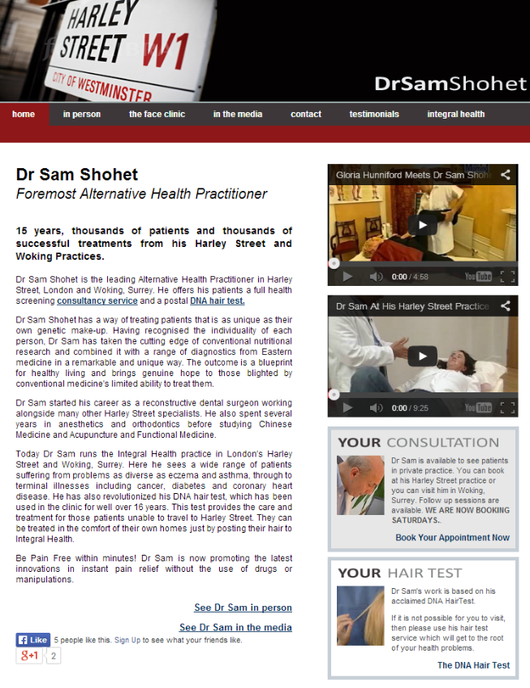
Integral Health
2014
Notes:
JT A14-265934

Slide 13
Any questions?
Notes:
Any questions?

Slide 14
The Broadcast rules
Section 8
Promotional Marketing, Use of the term ‘Dr’, and ‘No. 1’ claims
Notes:
JT
Promotional marketing. We are going to cover two element of promotional marking
I am going to talk about the more technical aspects of running a promotion and Victoria will talk more about social responsibility aspects of running promotions for cosmetic interventions.
The examples in this technical aspects relate primarily to ads we have seen in other sectors as we don’t have any good examples of rulings in your field. Victoria however will have some good and recent examples of

Slide 15
What do the rules
state?
Promotional marketing can provide an incentive for the consumer to buy by using a range of added direct or indirect benefits, to make the product more attractive.
The ‘promoter’ is whoever is running the promotion.
The Code applies to all stages of the promotion, not just the initial marketing, and applies anywhere that a promotion appears.
Promotional Marketing, Use of the term ‘Dr’, and ‘No. 1’ claims
Notes:
CH
Onto our focus on Section 8, which is is in the CAP code.
The BCAP Code does not have an equivalent dedicated section to promotional marketing, but the same principles apply.
Promotional marketing is defined as something which provides an additional incentive to make the product more attractive to the consumer. Its usually on a temporary basis.
The rules do not apply to routine, non-promotional, distribution of products or product extensions.
So something which is not time limited, for example a meal deal that runs all the time, or standard non promotional price fluctuations, including when stores advertise a ‘new lower price’, are not likely to be considered promotions.
The Code applies to all promoters involved in running a promotion. Often there can be joint promotors, and both will be held responsible by the ASA. An example of a promotion with joint promoters could be a competition or prize draw where one where promoter supplies the prize, and another advertises the promotion.
Its important to note that whilst there is a section in the CAP Code for promotions, if something is in remit, the entirety of the relevant Code will apply. Not just section 8

Slide 16


Examples of
promotional marketing
“Buy one get one free” offers and free trials
Special discount offers (e.g. customer incentives)
Competitions and prize draws
Prohibition on POM promotions
Social responsibility
Promotional Marketing, Use of the term ‘Dr’, and ‘No. 1’ claims
Notes:
CH
Here are some examples of some of the more common types of promotional marketing techniques.
This is a non exhaustive list, and other less common types of promotions which aren't on this list may be text to win promotions, cashback offers,
Helpful to point out that packaging/POS is not normally considered advertising for the purposes of the code, and is not in remit of the Code, unless it includes a promotion.
Where it does only the promotional element of that packaging or POS material will be in remit. If you are concerned about content on packaging that is not linked to the promote you will need to talk your Trading Standards contact. We understand that you are already pretty hot on health and nutrition claims so we are not going to touch on that today – mainly because we only have an hour and that would be a presentation it itself.
So we have some good case studies to look at today to try and illustrate how the main rules are applied by the ASA in practice. We have included a few on-pack promotions and some social media ads as we understand this is where most of your promotions are advertised. There may be a few other ad mediums included because they are better placed to illustrate the point we are making

Slide 17
The Broadcast rules
Administration
Promotional Marketing, Use of the term ‘Dr’, and ‘No. 1’ claims
Notes:
CH

Slide 18



Administration
  Key principles:
Responsible for all elements of the promotion.
Should be administered fairly and not unnecessarily disappoint consumers.
Plan ahead to avoid the risks of changing the terms.
Allocate adequate resources to administer the promotion.
Prizes should be awarded as described, or a reasonable equivalent.
Take care that appropriate measures are in place to ensure that the structure, or mechanic, of the promotion is not open to abuse.
Promotional Marketing, Use of the term ‘Dr’, and ‘No. 1’ claims
Notes:
CH
The rules which relate to the administration of promotions state that all promoters are responsible for all elements of the promotion.
Promotions should be administered fairly, and promoters should not unnecessarily disappoint consumers
Promoters should plan ahead, and think about the resources, including financial resources, people, and time that are needed to run the promotion smoothly.
Prizes should be awarded as described, or if that isn't possible, a reasonable equivalent should be awarded.
A reasonable equivalent is likely to be one which is of similar nature, and value, to the prize advertised. So as an obvious example, you cant advertise two weeks in the maldives, and replace it with a weekend in the UK.
Advertisers should put appropriate measures in place to ensure that the structure, or mechanic, of the promotion is not open to abuse.
Changing terms and conditions part way through to combat abuse is likely to be problematic and promoters should think ahead.
for example, if a promotion is limited to one entry per household, this must be included in the initial material for the promotion, if this term is subsequently added to enable promoters to disqualify those who are entering multiple times, this is likely to be a breach. The promoter should have considered this possibility beforehand, and included this in the initial terms.

Slide 19
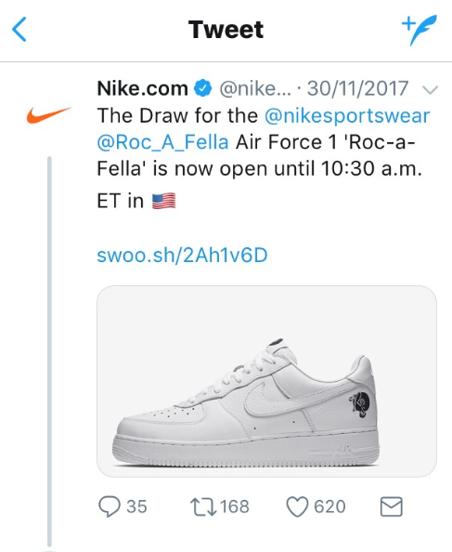
Nike European Operations BV
2018
Promotional Marketing, Use of the term ‘Dr’, and ‘No. 1’ claims
Notes:
CH
POLL QUESTION- Do you think this ruling was upheld or not upheld? (Go through the promotion, provide some context, ask the question and then discuss based on how people vote)
Nike - A18-410518 - https://www.asa.org.uk/rulings/nike-european-operations-netherlands-b-v--a18-410518.html
A promotion on Twitter by Nike which offered as the prize the opportunity to purchase a pair of shoes
The complainant, who was informed that they had won, but had not received the shoes, challenged whether the promotion had been administered fairly
Nike said the outcome for the complainant was unfortunate but was not brought about by inadequate operation of the promotion by Nike.
Nike explained that the promotion was run on 30 November 2017. In line with the terms and conditions, the complainant won the opportunity to purchase the shoes and their card was automatically charged for the purchase price. The shoes were then promptly dispatched using their standard distribution channel on 30 November 2017.
On 18 December 2017, Nike were notified that the complainant had not received the shoes. They immediately placed a tracer on the relevant parcel to try to identify the location of the shoes and when that was unsuccessful, it promptly (2 January 2018) apologised to the complainant, issued a full refund and offered a 20% discount voucher. On 3 January 2018, Nike confirmed to the complainant that it was unable to provide a replacement pair of shoes as they were a limited edition item and there was no surplus stock available. They said it was unfortunate that in some instances goods went missing in transit, and that, given the nature of the promotion, it was not possible on this occasion to source a replacement item for the complainant. However, Nike said that did not represent a failure to manage the promotion responsibly.
Nike said participants were aware that the promotion provided the opportunity to purchase a one-off item of which there was very limited stock available. They said the situation was comparable to the prize of a one-off piece of artwork which was lost in transit to the winner. The premise of the promotion provided sufficient warning to participants that the shoes were a limited edition item and therefore limited stock was available. They would therefore understand that were stock to be damaged or lost, no further stock would be available to winners.
Nike said their promotion should be distinguished from a previous promotion in which the ASA had ruled that a percentage discount voucher was not a reasonable equivalent to a prize that had been lost in transit because no purchase was required to win the original prize but a purchase was required to gain the benefit of the discount. They pointed out that in their promotion a purchase was required to win the prize, that they had provided a full refund of the purchase and that they had issued an additional 20% off voucher as a goodwill gesture to alleviate the disappointment of the complainant.
We understood that Nike regularly ran promotions that offered consumers the opportunity to buy limited edition items. While the tweet did not explicitly state what the prize was, we considered those who followed Nike on Twitter would be familiar with the type of promotion and would therefore understand, as the complainant did, that by entering “The Draw” they were applying for the opportunity to buy the featured shoes, not to win them as a prize.
We accepted that the complainant received his prize – the opportunity to buy the shoes – and that the problem that arose was with the delivery of the shoes to the complainant. However, the CAP Code (the Code) stated that promoters were responsible for all aspects and all stages of their promotions, and we considered that extended to delivery by third-party carriers of items which participants in a promotion had won the right to buy.
The Code also required that promoters award the prizes as described in their marketing communications or reasonable equivalents. It was clear from the nature of the promotion that only a limited number of the shoes were available, but we considered that consumers would still expect a business of the size of Nike to have sufficient stock to be able to ensure promotion winners could receive the items they had won the right to buy, even taking into account the foreseeable risk of some items being lost or damaged. We therefore considered that Nike should have been able to source and supply a replacement pair of the shoes to send to the complainant.
In the circumstances in which Nike would be unable to provide a replacement pair of shoes, Nike would refund the complainant and provide a 20% discount voucher to be used on a future purchase. We considered that a “reasonable equivalent” to the prize to buy a pair of limited edition shoes would have been the opportunity to buy another item of clothing that was similarly limited and that cost a similar amount to buy.
Because Nike failed to ensure that the promotion winner received the item he had won the opportunity to buy and because they failed to offer him the opportunity to buy a reasonable equivalent item, we considered that Nike had failed to conduct the promotion equitably or efficiently and had as a result caused undue disappointment to the winner.

Slide 20
The Broadcast rules
Promotional Savings
claims
Promotional Marketing, Use of the term ‘Dr’, and ‘No. 1’ claims
Notes:
Savings claims are a common promotional tool. Marketers may wish to communicate the savings customers can make by using reference prices for individual products or services, such as “was £9.99”, or when promoting for a range, such as “up to 50% off women’s clothing”. Marketers making claims about the relative cost of their product should ensure that they make the basis of the comparison clear and follow the guidance below to ensure their pricing does not mislead consumers.
In the next slide we’ll discuss the key principles advertisers need to consider when making promotional savings claims

Slide 21




What do I need to remember?
Reference prices must not mislead
The basis of the comparison is clear
“up to” and "from" claims must not exaggerate potential savings
Do not artificially inflate prices
Use the correct terms for introductory offers
Promotional Marketing, Use of the term ‘Dr’, and ‘No. 1’ claims

Slide 22

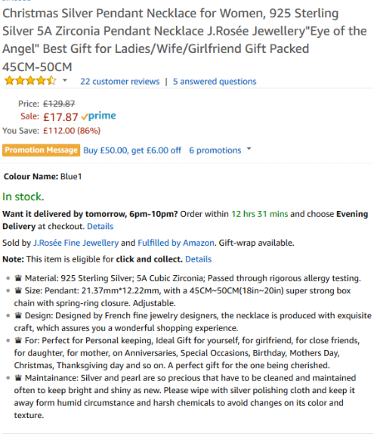

J Rosee Fine Jewellery
2017
Promotional Marketing, Use of the term ‘Dr’, and ‘No. 1’ claims
Notes:
A17-405832
The complainant challenged whether the savings claim was misleading and could be substantiated
We considered that consumers would understand the claim "You Save: £112.00 (86%)" to represent a genuine saving against the advertiser’s usual selling price for the product at the time the ad appeared. We noted that the pricing history from various price tracking websites provided by the complainant indicated that the product had not been on sale for more than £25 within the past 12 months. Because we had not been provided with any evidence that £127.87 was J Rosee’s usual selling price for the item, we concluded that the savings claim had not been substantiated and was therefore misleading.

Slide 23

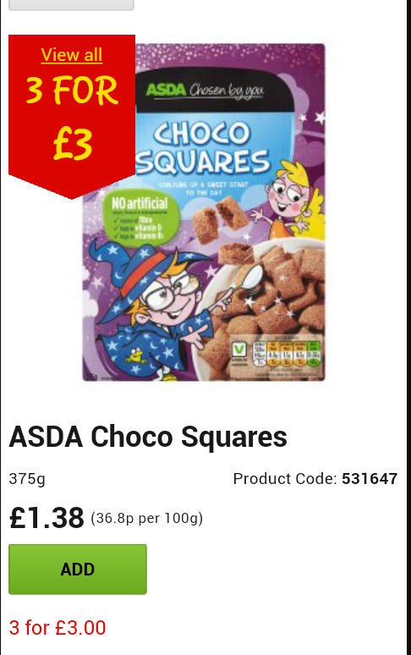
ASDA Stores
2015
Promotional Marketing, Use of the term ‘Dr’, and ‘No. 1’ claims
Notes:
A15-309400
Issue
The complainant, who understood the price of the product was increased from 97p per box prior to the promotion, challenged whether the ad was misleading.
ASDA Stores Ltd said their Choco Squares cereal was priced at 97p per box between January 2015 and 5 July 2015, and at £1.38 from 6 July 2015. On 7 July 2015 the product was then included in a mix and match multi-buy offer of three packs for £3. The product price was then again changed, to £1.20 on 9 September 2015. They said the ad communicated the current selling price of £1.38 for an individual pack and that all other information was present in the ad in order for a customer to make an informed decision about whether or not to purchase the product. Furthermore, the ad did not make any implied comparison with the product’s past price. They said a customer could choose to purchase one pack of Choco Squares product for £1.38, or choose to buy three boxes for £3. ASDA said had the product not been included in the three for £3 offer at the time of the ad, a customer would have paid £4.14 for three boxes. Therefore, because Choco Squares were included in the offer, a customer would have saved £1.14 for the same number of products
We noted ASDA’s assertion that the ad clearly communicated the current selling price of an individual pack of Choco Squares as £1.38. However, we considered consumers were likely to understand that the individual pack price of £1.38 was both the current and the usual selling price, and that the promotional price of three for £3 therefore represented value for money when multiple items were purchased. We considered the promotion was likely to encourage consumers to purchase multiple packs of Choco Squares when previously they might have purchased only one, based on the ad’s suggestion that a genuine saving was available.
We understood the product had been priced at 97p for around six months up to 5 July and that it was changed to £1.38 on 6 July, which represented an increase of 42%. The product then became part of the multi-buy offer on 7 July, one day after the price was increased. We considered that the price of 97p was clearly the usual selling price at the time the multi-buy offer was introduced, rather than £1.38, as suggested by the ad.
Because the ad suggested the usual selling price of their Choco Squares was £1.38, and implied a saving could be achieved against the usual selling price when that was not the case (indeed, when the multi-buy unit price was more expensive than the usual selling price), we concluded that it was misleading.

Slide 24
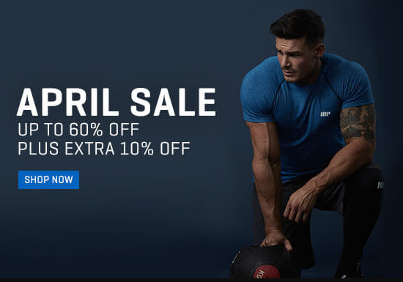
The Hut.com
2017
Promotional Marketing, Use of the term ‘Dr’, and ‘No. 1’ claims
Notes:
A17-386486
The complainant, who was unable to find any items on the website that were discounted by 60%, challenged whether the claim “April sale up to 60% off” was misleading and could be substantiate
The Hut.com Ltd t/a MyProtein stated that when the promotional email was sent on 25 April 2017, the MyProtein website had 1,796 unique items and 145 of those items were subject to a 60% discount or higher, meaning that over 8% of the items were available for purchase at a discount of 60% or higher during the April sale. They provided a spreadsheet detailing each of those 1,796 items, the pre-sale prices, the prices at which those items were offered during the sale and the amount of discount applied. They believed that given the circumstances, the fact that 8% of the total number of items was discounted at 60% or more constituted a significant proportion, given the number of unique items available for purchase during the April sale
The ASA considered that consumers were likely to understand from the claim “UP TO 60% OFF” that all of the products available for purchase on the MyProtein website would have some level of discount, and that a significant proportion of those items would be discounted at 60%. We considered they would expect the claim to represent the true overall picture of the sale. In other words, that products which were discounted, including those discounted by 60%, would be distributed across all price ranges.
We noted that the spreadsheet provided by MyProtein indicated that 145 out of the 1,796 items that they sold (8% of all the items available) were discounted at 60% or more during the April sale, and that all of the other products had some level of saving. The pre-sale prices of all of the items ranged between £0.99 and £149.99: 1,678 items were priced between £0.99 and £49.99 prior to the sale, and 7.93% of those were discounted by 60% or more; 112 items were priced between £50 and £99.99 prior to the sale, and 10.71% of those were discounted by 60% or more; only six items were priced between £100 and £149.99 prior to the sale, and none of the items in that range were discounted by 60% or more.
Although we did not consider that the overall distribution of products discounted at 60% or more fell disproportionately in any particular price ranges, we did not consider 8% of the total number of products available during the April sale constituted a significant proportion of the sale items. Because we considered consumers were likely to expect that a significant proportion of items would be discounted at the claimed maximum discount, and that was not the case, we concluded that the claim “UP TO 60% OFF” had not been substantiated and was likely to be misleading.

Slide 25
The Broadcast rules
Significant
conditions
Promotional Marketing, Use of the term ‘Dr’, and ‘No. 1’ claims
Notes:
JT
We are going to move on to significant conditions now. This is something we see a lot of because to a lesser or greater extent, promotions have conditioned attached.

Slide 26
Significant
conditions
All marketing communications referring to promotional marketing must communicate all significant conditions or information where the omission of such conditions or information is likely to be misleading.
Promotional Marketing, Use of the term ‘Dr’, and ‘No. 1’ claims
Notes:
JT
and these are things that are likely to be included in all promotions. Some are going to be more indepth that others but the nature of promotions mean there are going to be specific restrictions or conditions that will need to be made clear.
The principles is that significant conditions that are likely to affect a decision to participate, or find out more about a promotion, will need to be included in an ad for that promotion.

Slide 27








What is likely to be considered a significant condition?
How to participate
Free entry route explained
Start date and closing date
Proof of purchase
Any limitations on availability
Number and nature of prize and gifts
Any restrictions that apply
Promoters name and address
Promotional Marketing, Use of the term ‘Dr’, and ‘No. 1’ claims
Notes:
JT
Significant conditions are those which are likely to effect a consumers understanding of the promotion.
Rule 8.17 sets out examples of the types of things which are likely to be considered significant conditions which are on the slide now.
So just to go into a few of these in a little more detail –
Closing dates must be included, unless they are not necessary (for example, in promotions which are limited by availability, rather than time).
Closing dates should not be extended unless;
- Unavoidable circumstances beyond the control of the promoter make it necessary and
Not to change the date would be unfair to those who sought to participate within the original terms or those who sought to participate within the original terms will not be disadvantaged by the change
For example, not receiving enough entries to a prize draw by the closing date would not be an unavoidable circumstance beyond the promoter's control, and extending the date to allow more entries would reduce current participants chances of winning, so would be unacceptable.
All restrictions, such as eligibility requirements are also likely to be significant
As are details about how to participate, and the nature and number of prizes or gifts available

Slide 28

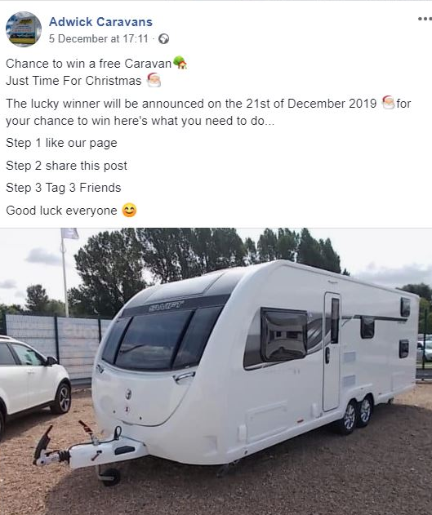
Where should significant
conditions be shown?
  Must be prominent in all advertising and positioned close to the headline offer.
  If a promotion appears in time and space which is significantly limited, must include as much information about significant conditions as practicable and direct consumers to an easily accessible alternative source where they are all stated.
Promotional Marketing, Use of the term ‘Dr’, and ‘No. 1’ claims
Notes:
JT
So where should these significant conditions be?
We have seen from the ASA applying this rule multiple times, ,that significant conditions must be clear and prominent, usually close to the headline claim. It shouldn't be easy for viewers to miss them because they are illegible or hidden.
Some promotions can be limited by space and it could be the case that not all terms and conditions need to be stated in the initial ad
Code rule 8.18 states that if there is not enough space for significant conditions, promoters should include as much information about significant conditions as they can and direct consumers clearly to an easily accessible alternative source where the significant conditions are prominently stated
For example, if the ASA consider an ad to be sufficiently limited, it might be acceptable for those less significant conditions which cannot be included in the ad, to be stated prominently on the landing page when consumers click through from the initial ad.
AS LONG AS the Initial ad indicates that terms and conditions apply
BUT its really important to know that the ASA is strict about what constitutes limited by space or time.
Media that are unlikely to be considered limited by space : promoter’s own website, email, some social media e.g. promoter’s own pages, maybe Twitter (because whilst there is a character limit, promoters can include images and videos in the post, and can tweet multiple times in a row with an indication in each Tweet that it is one in a series)
Media that might be limited by space or time: some press ads but these are assessed case by case, and Google ‘sponsored’ searches
It may be that the ASA consider some promotions should not be advertised in space limited by time or space, as the omission of significant conditions would mislead.
Participants should be able to retain those conditions or easily access them throughout the promotion
If the promotion in question is on-pack you need to find a way to ensure that the as much information about about the significant conditons is made as clear as possible on the pack. On pack promotions could easily be considered misleading if material information about the promotion is omitted. The rule of thumb is to avoid complex promotions for on-pack promotions. The ASA would take a dim view on promotions which are too complicated to properly explain how its going to operate.

Slide 29
The Broadcast rules
Prize
Promotions
Promotional Marketing, Use of the term ‘Dr’, and ‘No. 1’ claims
Notes:
JT

Slide 30


What do the rules
state?
Don’t exaggerate consumers’ chances of winning or imply that consumers are luckier than they are.
Differentiate between prizes and gifts.
Full T&C’s available throughout promotion and should not be changed partway through.
Prize promotion specific terms must be
included.
Promotional Marketing, Use of the term ‘Dr’, and ‘No. 1’ claims
Notes:
JT
When advertising prize promotions, ads must not exaggerate peoples chances of winning, or imply that participants or potential participants are luckier than they are.
Its important to consider terminology – and promoters should avoid using terms like “finalist” or “final stage”, and shouldn’t suggest that participants have advanced beyond other participants, if that isn't the case.
Ads shouldnt imply that all prizes will be won if they will not. Sometimes, it will be important for an ad to include details about the mechanism of the promotion, particularly if it is the case that the chances of winning are relatively slim due to the promotions mechanism. Without this information, the ad may exaggerate participants chances of winning.
Promotions must not mislead about whether a promotion is skill or chance based:
Promotions for which no skill or knowledge is necessary should not be described as a competition or otherwise imply that anything but chance is involved.
Ads must not cause confusion about what is a gift, and what is a prize.
Gift – significant prop or participants or all participants
Prize – something awarded to a small minority.
And in relation to the terms for the prize promo, any specific terms must be included, terms must not be too complex for consumers to understand, and the full terms and conditions must be accessible throughout the promotion.
Wouldn’t be ok to have full terms on the back on an entry sheet.
Terms shouldn’t be changed, unless the change is nessesary due to factors outside of the adv’s control and the advertiser communicates the change to participants and potential participants.
The ASA has ruled that creating and enforcing T&Cs retrospectively is unacceptable - even if the aim is to combat abuse.

Slide 31
How should I select
winners?
Ensure winners of prize draws are selected randomly.
If winner selection is subjective, winners must be selected by an independent judge, or a panel which includes at least one independent member.
Participants in instant-wins must get their winnings at one, or know immediately what they have won and how to claim without delay, cost or administrative barriers.
Instant-win tickets, prizes, tokens or numbers should be awarded in a fair and random way that has been independently audited.
Promotional Marketing, Use of the term ‘Dr’, and ‘No. 1’ claims
Notes:
JT
In prize draws where prizes are awarded in accordance with the laws of chance, advertisers must ensure that they can demonstrate that they were awarded randomly e.g. by verifiably random computer software, an independent person, or under supervision of an independent person
Participants in instant-win promotions must get their winnings at once or must know immediately what they have won and how to claim without delay, cost or administrative barriers.
Instant-win tickets, tokens or numbers must be awarded on a fair and random basis and verification must take the form of an independently audited statement that all prizes have been distributed, or made available for distribution, in that manner.
Where winners are selected based on subjective criteria, winners must be selected by an independent judge, or a panel which includes at least one independent judge. This person must be verifiably independent, they must not be connected to the promoter or the pool of entrants, and staff of the promoter will not be considered independent.

Slide 32
The Broadcast rules
Promotions and social responsibility.
Promotional Marketing, Use of the term ‘Dr’, and ‘No. 1’ claims
Notes:
VA

Slide 33



How do I ensure promotions are responsible?
Promoters must do everything reasonable to ensure that their promotions, including product samples, are safe and cause no harm to consumers or their property. Literature accompanying promotional items must give any necessary warnings and safety advice.
Promotions must not be socially undesirable to the audience addressed by encouraging excessive consumption or irresponsible use.
Don’t put consumers under undue pressure.
Promoters must do everything reasonable to ensure that unsuitable or irresponsible material does not reach consumers or other recipients.
Don’t trivialise the decision to undergo a procedure.
Don’t exploit insecurities.
No promotion or promotional item should cause serious or widespread offence to consumers.
Do not use degrading, objectifying or gender stereotyping imagery, or create pressure to conform to an idealised gender stereotypical appearance.
Promotional Marketing, Use of the term ‘Dr’, and ‘No. 1’ claims
Notes:
VA In the last session we discussed the requirement for ads to be prepared with a sense of responsibility to consumers and to society. This included by not putting undue pressure on consumers, not trivialising the decision to undergo a procedure, not exploiting insecurities, and not using degrading, objectifying or gender stereotypical imagery or creating pressure to conform to an idealised gender stereotypical appearance. These also need to be taken into consideration when preparing ads for promotions.
In additional to ensuring that promotions are conducted fairly, the Code also requires that promotions are run responsibly.
Promoters must do everything reasonable to ensure that the promotions, including product samples, are safe and cause no harm to consumers.
They must not encourage excessive consumption or irresponsible use.
And promotions shouldn’t cause serious or widespread offence

Slide 34
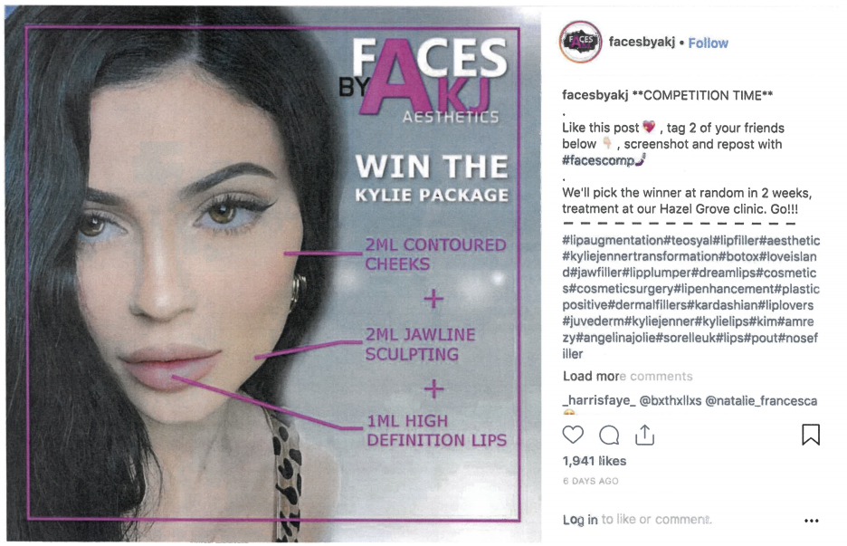
Faces By AKJ Aesthetics Ltd
2019
Promotional Marketing, Use of the term ‘Dr’, and ‘No. 1’ claims
Notes:
https://www.asa.org.uk/rulings/faces-by-akj-aesthetics-ltd-A19-565851.html
In addition to promoting Botox, this ad also breached the Code because … The ASA noted that the ad promoted a non-invasive cosmetic procedure as a competition prize through use of “hashtags” and “likes” on Instagram. The ad also used the statements “COMPETITION TIME” and “Go!” which we considered encouraged consumers to take part in the competition. We also noted that the ad was accessible to anyone visiting the website and so might have been viewed up until the offer deadline by consumers who were previously unaware of the competition, and they would therefore not have had a reasonable amount of time to consider the decision to take part.
We considered the presentation of those elements in the context of a competition were likely to give the impression that the decision to undergo cosmetic procedures such as jawline sculpting, cheek contouring or lip fillers surgery was a decision that could be undertaken lightly, without serious consideration of the nature of the intervention. On that basis we considered, therefore, that the ad irresponsibly offered a cosmetic procedure as a competition and concluded that it breached the Code.

Slide 35
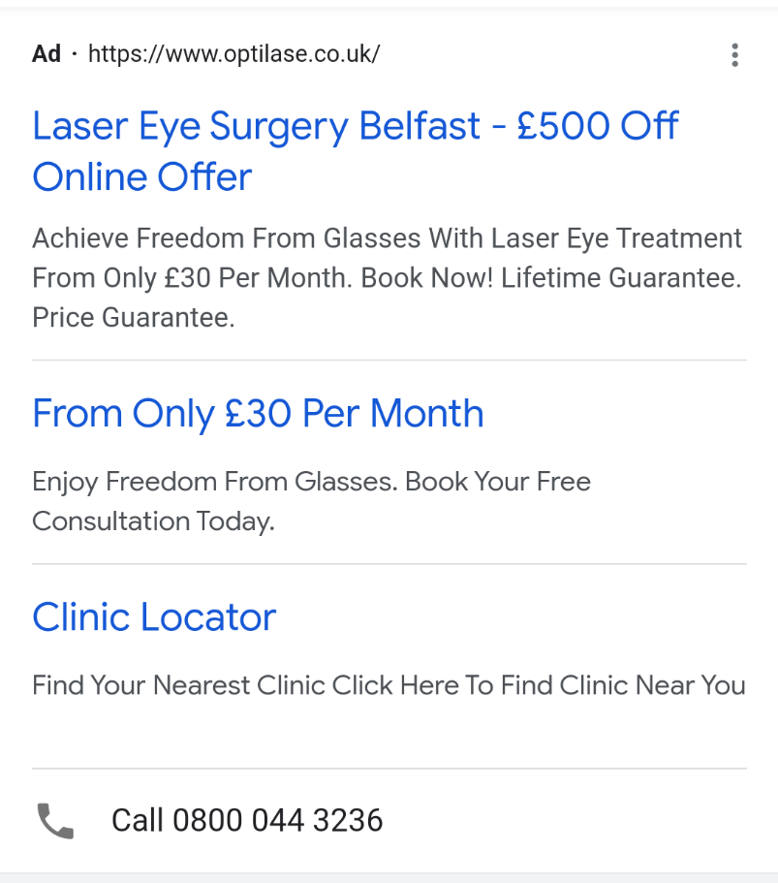
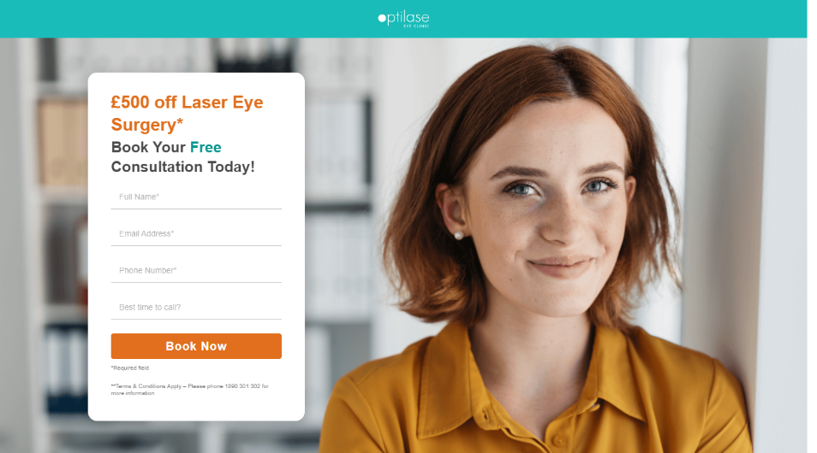
OPTILASE (UK) LIMITED
2022
Promotional Marketing, Use of the term ‘Dr’, and ‘No. 1’ claims
Notes:
https://www.asa.org.uk/rulings/optilase--uk--limited-a22-1141182-optilase--uk--limited.html
We understood that laser eye surgery was a serious medical procedure that could require long-term aftercare. We considered the promotion encouraged consumers to opt-out of life-long aftercare for the surgery in order to obtain a significant discount on the procedure without being sufficiently informed. We considered that effect was exacerbated by, as referenced at point 1, the fact a significant condition to the promotion had not been adequately communicated to consumers.

Slide 36
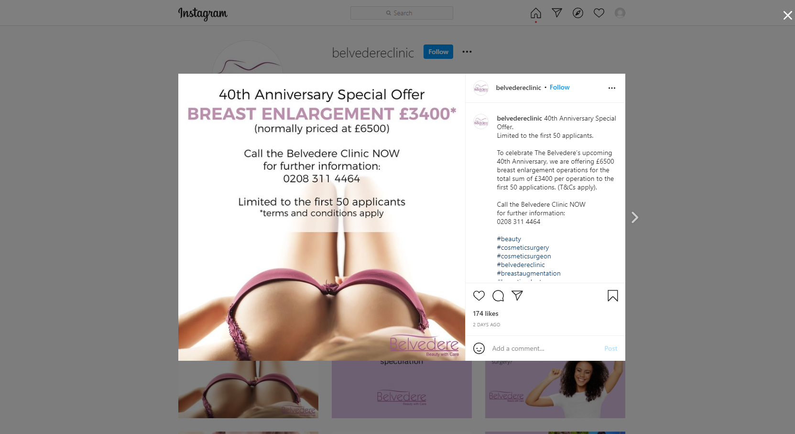
The Belvedere Clinic Ltd
2021
Promotional Marketing, Use of the term ‘Dr’, and ‘No. 1’ claims
Notes:
https://www.asa.org.uk/rulings/the-belvedere-clinic-ltd-g21-1124283-the-belvedere-clinic-ltd.html
We considered that cosmetic surgery should be portrayed as something which required time and thought from consumers, due to the seriousness of a decision to undertake an invasive medical procedure. We considered that by limiting the promotion to the first 50 applicants, and urging potential consumers to “Call the Belvedere clinic NOW”, the ad created an undue sense of urgency for potential consumers to respond immediately. Although we welcomed The Belvedere Clinic’s willingness to engage with our investigation and make changes to their advertising, because that sense of undue urgency to respond immediately had been created, we considered that the ad had not been prepared in a socially responsible manner, and therefore concluded the ad breached the Code.

Slide 37










What the key things to remember?
Don’t exaggerate people's chances of winning
Plan the promotion in advance, ensure you have the resources and can administer it fairly
Make a reasonable estimate of demand
Make full terms accessible throughout and don’t change them
Include significant conditions
Substantiate “No 1” and “Best Claims”
Ensure the promotion is responsible.
Be careful when using the term “Dr”
Remember the rest of the Code applies
Promotional Marketing, Use of the term ‘Dr’, and ‘No. 1’ claims
Notes:
Ok, so we have covered most of the key considerations for promoters to consider when planning and running a promotion.
In summary, here’s what the ASA is likely to expect promoters to do when running promotions:
Plan the promotion in advance and make sure there are adequate resources to ensure that each stage is administered properly
Where applicable, make a reasonable estimate of demand and make sure that consumers are made aware in a timely manner if that demand cannot be fulfilled
Think about which are the significant conditions and present them prominently in the ads
Ensure the promotion is responsible, particularly in relation to promotions targeted at children or those for products like alcohol and HFSS products.
For prize promotions,
Don’t exaggerate peoples chances of winning. Don’t confuse between gifts and prizes.
Make full terms and conditions accessible throughout and don’t change them, unless they meet the criteria set out in the code (contain nothing that could reasonably have influenced consumers against buying or participating and participants are told how to get them).
ensure that the winners are selected either randomly or independently, depending on the type of prize promotion
Award the prizes
We have advice online articles on all of these topics and more, which explain the ASA position in detail and give examples of ASA decisions.

Slide 38
Any questions?
Notes:
Any questions?

Slide 39


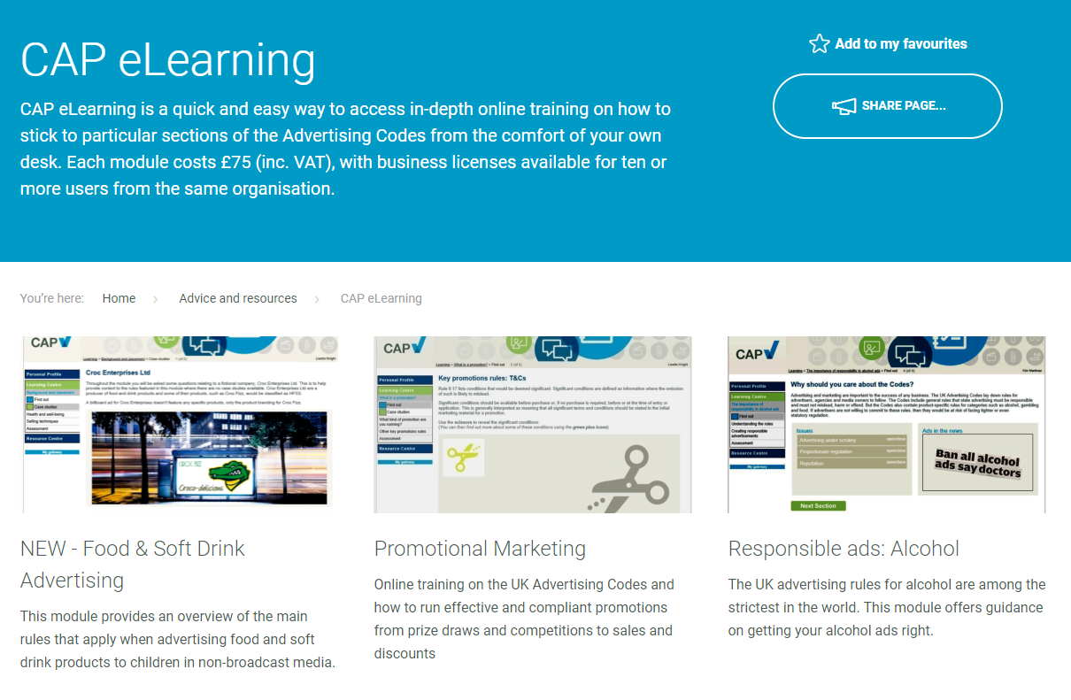
CAP eLearning
Modules:
  Insiders’ Guide to the ASA & CAP
  Responsible ads: alcohol
  Misleading Advertising (3 parts)
  Responsible ads: gambling
  Promotional marketing
  Social Media
  Food/HFSS
  Motoring
Notes:
eLearning is just one of many ways in which we aim to support advertisers to create responsible ads.
We have just launched a new Insider’s Guide module.

Slide 40
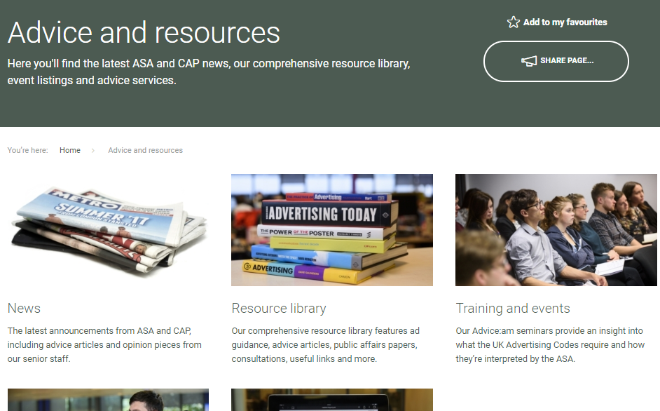
Other resources
Follow us on Twitter:
@ASA_UK @CAP_UK
Sign up to our newsletters Insight and Update
Regular training seminars and bespoke presentations
Copy Advice
Advice Online database
Check out weekly rulings
Notes:
400= guidance entires, 24 hour free Copy Advice.

